Slide 1

Inflation tax : printing money can lead to high rates of inflation
Phillips curve : short-run trade-off between inflation & unemployment
Okun’s Law: unemployment and output gap
Debt Deflation is a problem ; policy makers prefer a low, positive inflation rate, rather than deflation
The zero bound on nominal interest rate
The danger a liquidity trap
To First
Active Learning
To Video

Slide 2
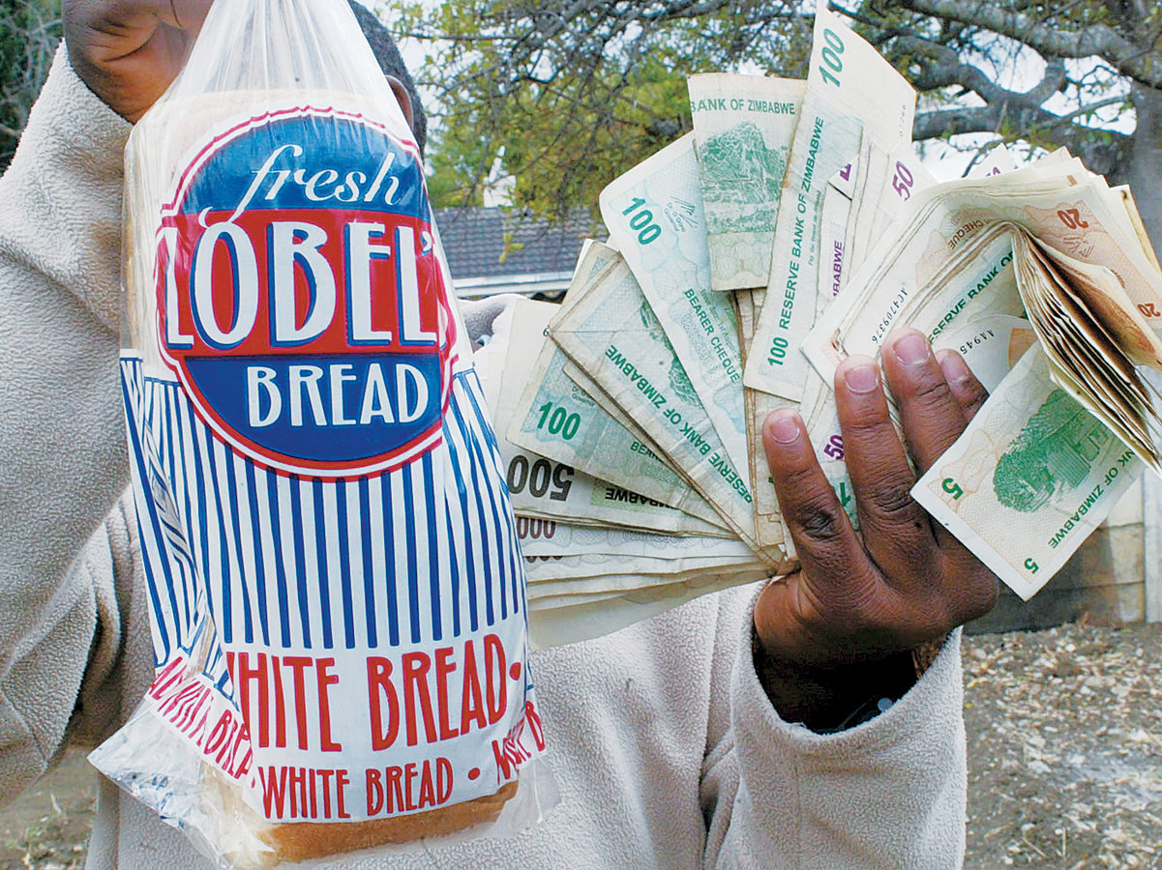
Money and Prices
What causes 500 billion percent inflation in Zimbabwe (2008) and Germany (1922–1923)?
Why did it spiral out of control in Armenia (27,000%) and Nicaragua (60,000%)?

Slide 3
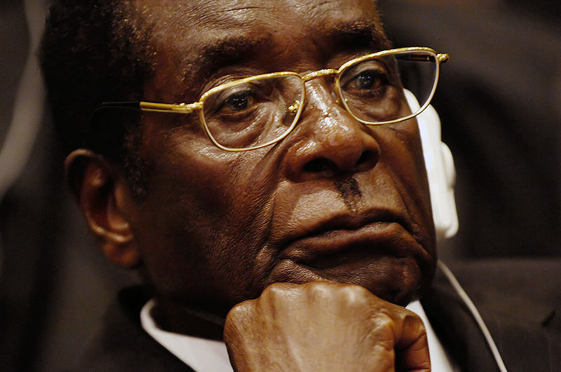
The Inflation Tax
What prevents a government from paying for its expenses by printing money?
Nothing. Just ask Robert Mugabe, Zimbabwe’s leader (and cause of its hyperinflation).
Zimbabwe’s Robert Mugabe:
A penny billion pennies for his thoughts.

Slide 4
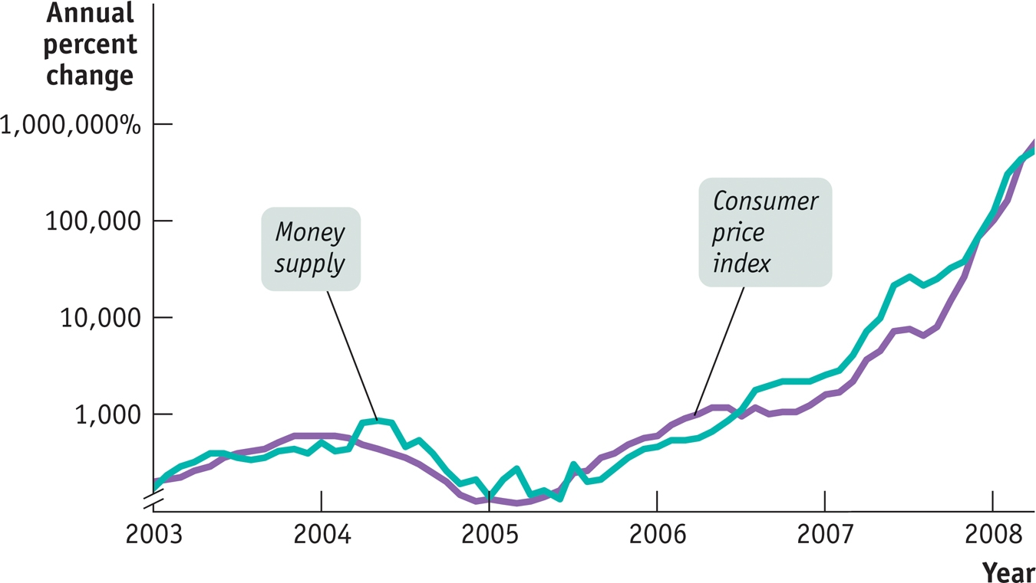
Money Supply Growth and Inflation in Zimbabwe
During periods of high inflation, money supply and inflation move together → the growth of money supply = inflation rate?

Slide 5
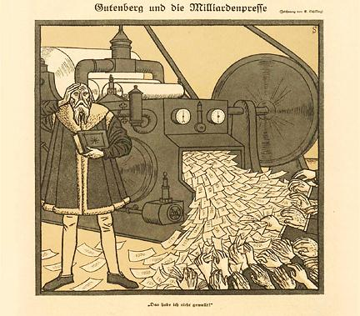
The Inflation Tax: the old days
Seignorage:
the revenue generated by a government’s right to print money. During the Civil War, 1860-65, both sides, North and South, printed money to finance the costs of war).

Slide 6
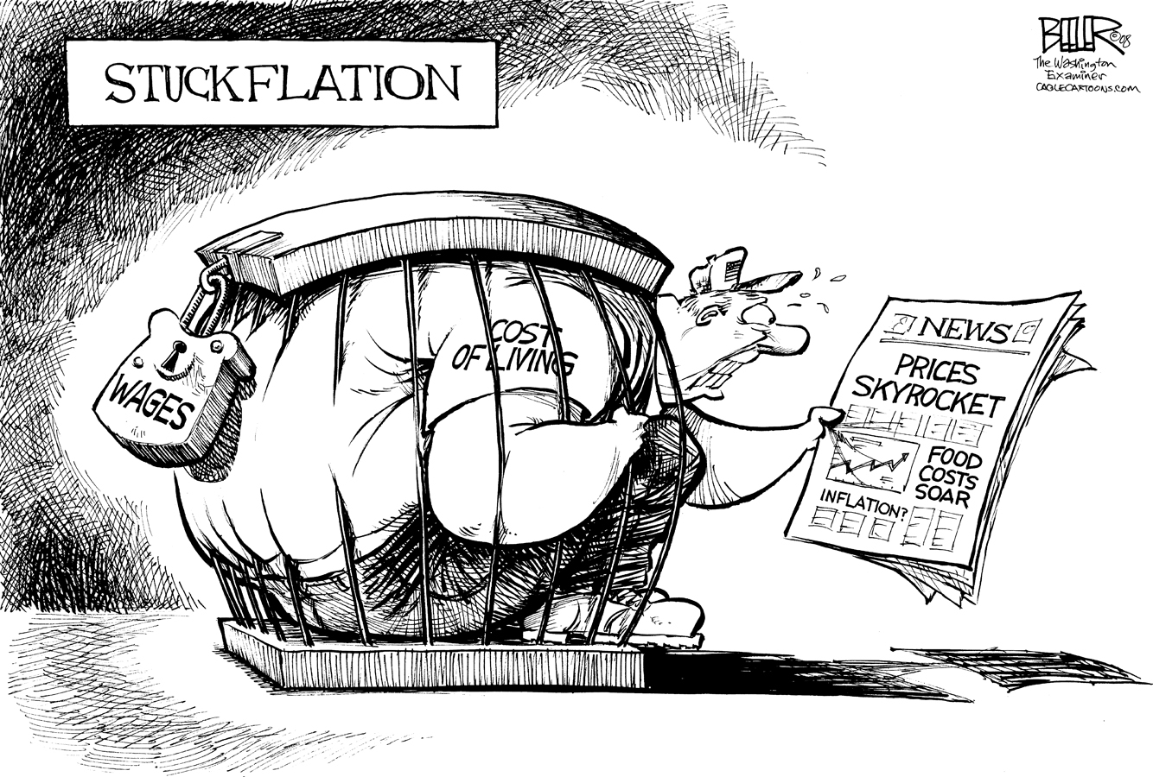
Inflation Tax
The inflation tax (the cost of inflation):
the reduction in the real value of money held by the public caused by inflation.
= the inflation rate × the money supply.
Seignorage = ΔM
where M = money supply and Δ = monthly change.
(It’s more useful to look at real seignorage, the revenue created by printing money divided by the price level, P.)
Real seignorage = ΔM/P
Rewritten to:
Real seignorage = (ΔM/M) × (M/P)
or
Real seignorage =
rate of growth of the money supply × real money supply.

Slide 7
The Logic of Hyperinflation
-During high inflation, as money lose its value by large and fast (“hot potato”), people avoid money holdings;
-it forces the government to increase inflation to capture the same amount of real inflation tax (to finance its expenses) – by printing more money.
-In some cases, this leads to a vicious cycle of a shrinking real money supply and a rising rate of inflation.
-This leads to hyperinflation.

Slide 8
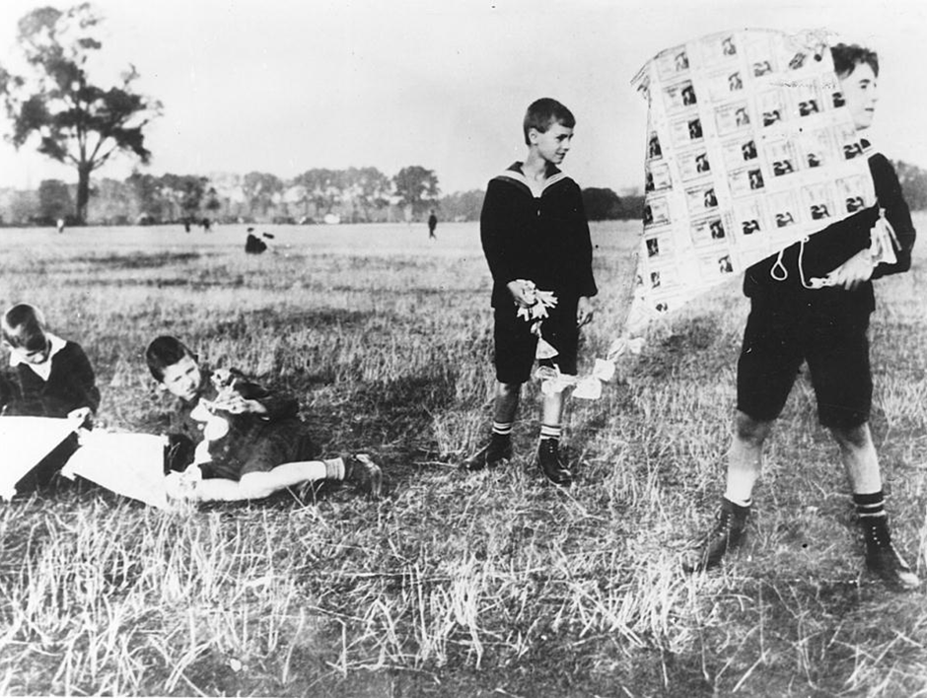
Hyperinflation
In 1923, Germany’s money was worth so little that children used stacks of banknotes as building blocks or built kites with them.

Slide 9
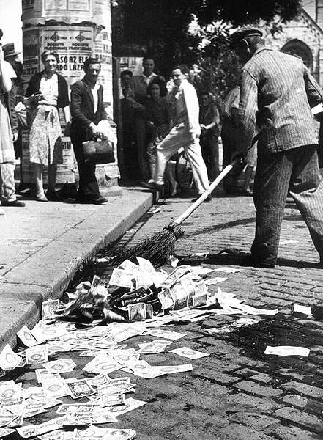
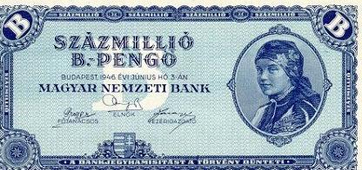
Hyper-Inflation
Hungary’s hyperinflation is the highest on record.
What cost 1 Hungarian pengo in 1945 cost 1.3 septillion pengos at the end of 1946. (how many zeros is a septillion?)
Prices doubled every 15 hours.
The worthless Hungarian pengo, 1946
100,000,000,000,000,000,000 Pengo
World's highest-denomination banknote: Hungary (1946), 100 quintillion pengo

Slide 10
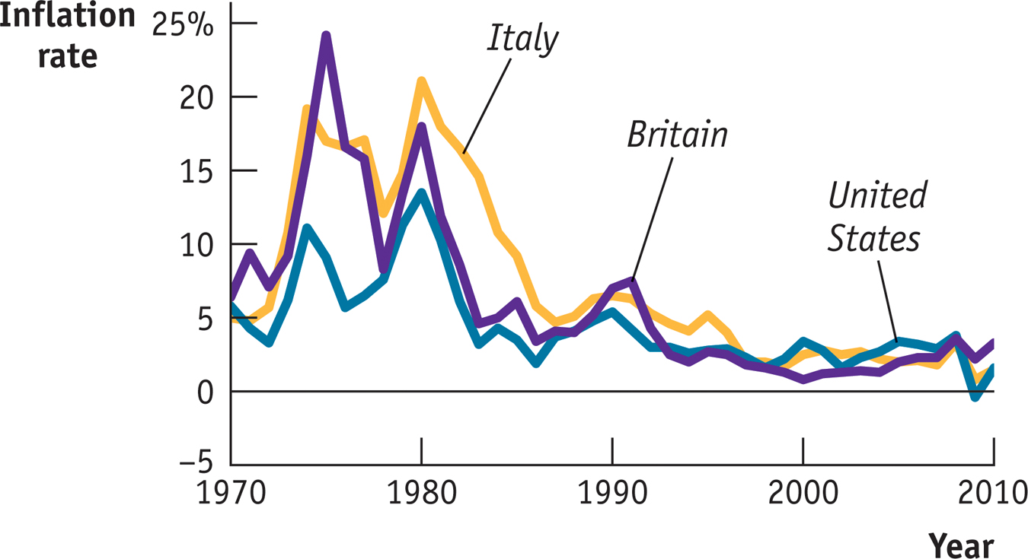
Moderate Inflation and Disinflation
The governments of wealthy, politically-stable countries like the United States and Britain don’t find themselves forced to print money to pay their bills.
Yet over the past 40 years both countries, along with a number of other nations, have had uncomfortable episodes of inflation.

Slide 11
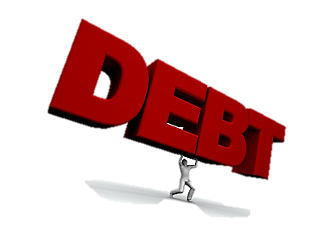
Debt Deflation
If Inflation is a problem, Deflation brings another problem:
For those who have debt (home loans, credit card loans, student loans), a deflation means the real interest rates the borrower has to pay will be higher.
Nominal interest rate - Real interest rate = inflation rate
Or
Real interest rate = Nominal interest – inflation
If Deflation is 2% due to the Housing crisis, when mortgage (nominal) rate was 6%;
the Real mortgage rate is: 6% - (-2%) = 8%
Since deflation is a negative inflation, Real interest rate is higher; purchasing power is lower, thus households would reduce spending on Consumption, and Total Output (GDP) reduced.
Debt deflation: the reduction in GDP arising from the increase in the real burden of outstanding debt caused by deflation.

Slide 12
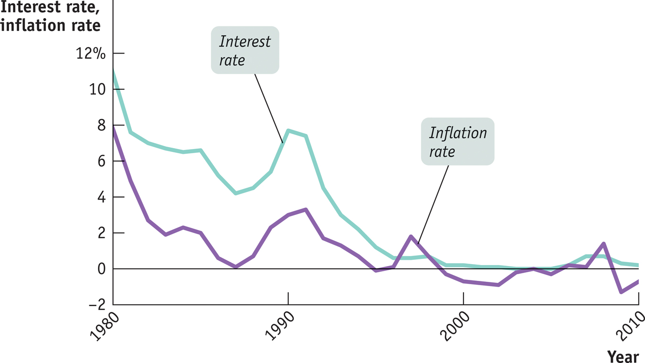
Japan’s Lost Decade & Deflation
After the 1980s housing and property boom went bust, Japan fell into persistent deflation. Monetary policy (Money supply and interest rates policy) can go only so far. A period of “liquidity trap” and zero interest rate (even negative at times).

Slide 13
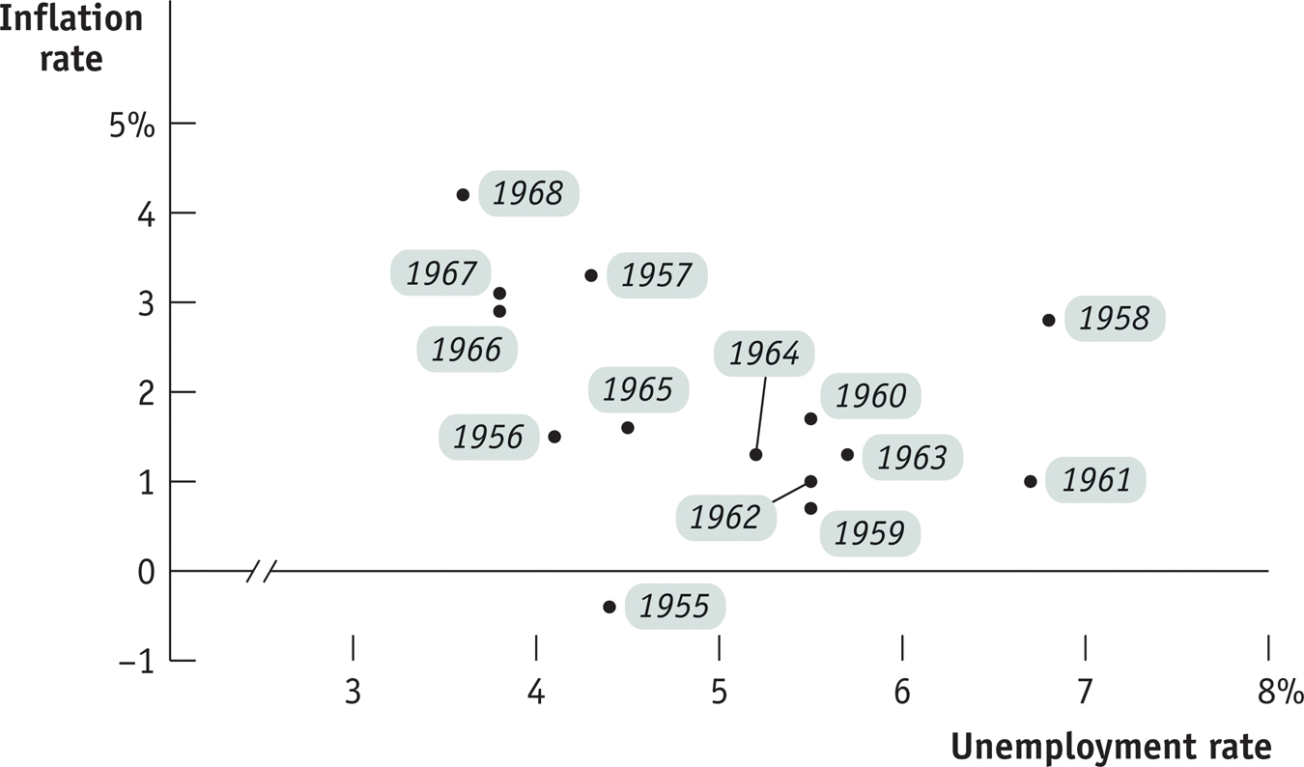
Short-Run Phillips Curve
The short-run Phillips curve: the negative short-run relationship between the unemployment rate and the inflation rate.
Source: Bureau of Labor Statistics

Slide 14
The Short-Run Phillips Curve
Inflation rate
When the unemployment rate is low, inflation is high.
0
When the unemployment rate is high, inflation is low.
Short-run Phillips curve, SRPC
Unemployment rate

Slide 15
The Short-Run Phillips Curve and Supply Shocks
Inflation
rate
… But Supply shocks (positive or negative) shifts the SRPC
A negative supply
shock shifts
SRPC up.
0
SRPC₁
Unemployment rate
SRPC₀
A positive supply
shock shifts
SRPC down.
SRPC₂

Slide 16
Inflation Expectations and the Short-Run Phillips Curve
One of the crucial discoveries of modern macroeconomics:
Changes in the expected rate of inflation affect the trade-off between unemployment and inflation and shift the SRPC
Inflation
rate
6%
5
4
SRPC shifts up by the amount of the increase in expected inflation.
3
2
1
SRPC₂
0
–1
3
4
5
6
7
8%
Unemployment rate
–2
SRPC₀
–3

Slide 17
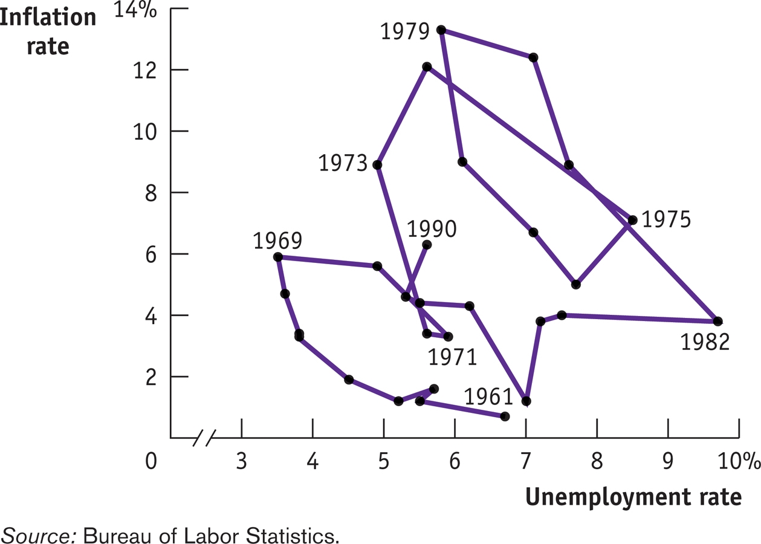
Unemployment and Inflation, 1955–1968
The Phillips curve explained fluctuations very well in the 1950s and 1960s. Then along came stagflation. Oil shocks and rising inflationary expectations created real problems.
Phillips Curve does not explain well when:
-high inflation due to Oil shocks
-hyperinflation due to Money Printing

Slide 18
The NAIRU and the Long-Run Phillips Curve
The long-run Phillips curve: the relationship between unemployment and inflation after expectations of inflation have had time to adjust.
Inflation
rate
Starting at E₀, If policy makers reduce unemployment to 4%, this raises inflation to 2%.
The economy reverts to its natural 6% unemployment, but SRPC shifts upward based on higher inflation.
If policy makers attempt to keep unemployment at 4% again, inflation continues to rise.
8%
7
6
C
5
B
E₄
4
3
A
E₂
2
SRPC₄
1
E₀
SRPC₂
0
3
4
5
6
7
8%
Unemployment rate
–1
Nonaccelerating inflation
rate of unemployment,
or NAIRU (natural unemploymet rate)
–2
SRPC₀
–3

Slide 19
NAIRU – Natural rate of Unemployment
The nonaccelerating inflation rate of unemployment, or NAIRU, is the unemployment rate at which inflation does not change over time (the natural rate of unemployment).
As of April 2012, the CBO estimate of the U.S. natural rate was 5.5%.
To avoid accelerating inflation over time, the unemployment rate must be close to the NAIRU) so that the actual rate of inflation matches the expected rate of inflation.
Disinflation is the process of bringing down inflation that is embedded in expectations. Once inflation has become embedded in peoples’ expectations, getting it back down can be difficult.
Disinflation can require a recession (as in the 1970s-1980s), and high unemployment.
However, policy makers in the United States and other wealthy countries were willing to pay that price to bring down the high inflation of the 1970s.

Slide 20
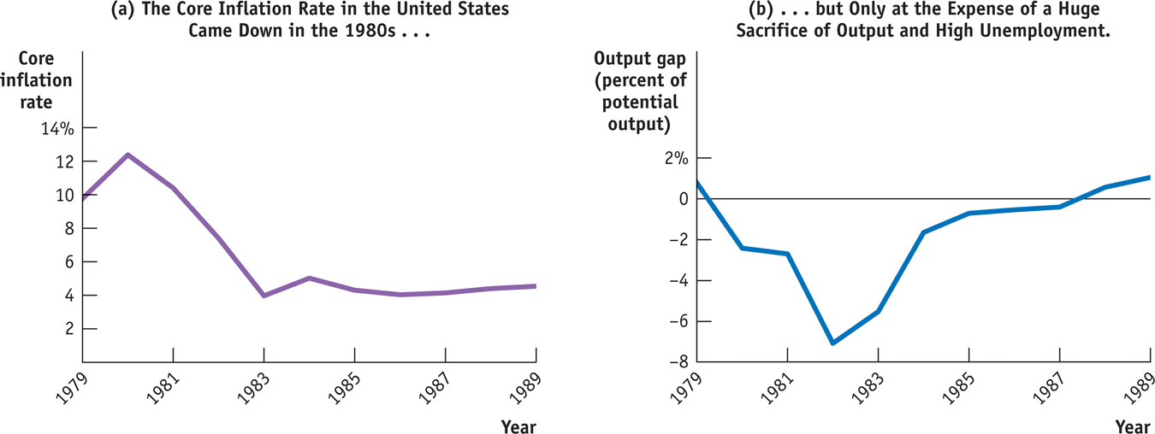
The Great Disinflation of the 1980s
Beginning in late 1979, the Federal Reserve imposed strongly contractionary monetary policies (reducing money supply), which pushed the economy into its worst recession since the Great Depression. It cost 18% of our annual output.

Slide 21
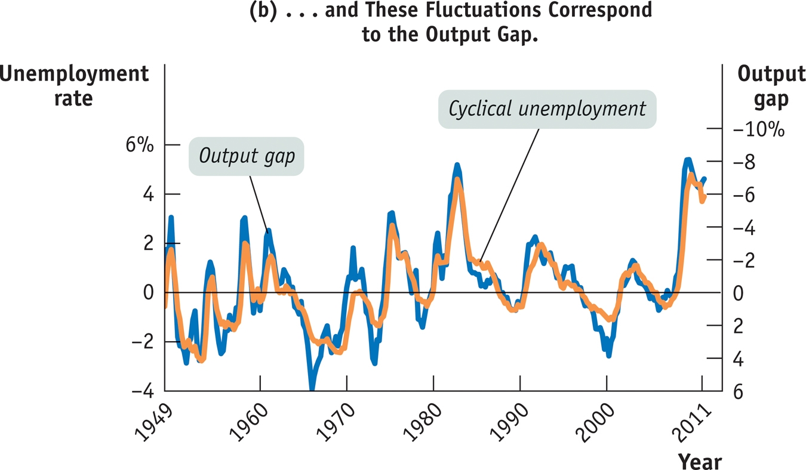
Cyclical Unemployment and the Output Gap

Slide 22
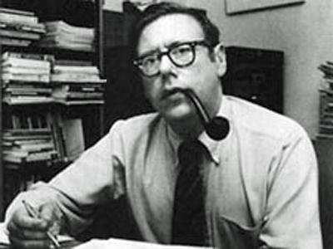
Okun’s Law
Cyclical unemployment seems to move less than the output gap. Ex: The output gap reached −8% in 1982, but cyclical unemployment reached only 4%. Arthur Okun, John F. Kennedy’s chief economic adviser, discovered this.
If the natural rate of unemployment is 5.2% and the economy is producing at only 98% of potential output (the output gap is −2%), and Okun’s law predicts an unemployment rate of: 5.2% − 0.5 × (−2%) = 6.2%.
Okun’s law: there is a predictable negative relationship between the output gap and the unemployment rate. Modern estimates find that a rise in the output gap of 1% reduces the unemployment rate by about 0.5%.
Unemployment rate =
natural rate of unemployment – 0.5 x (output gap)
If the total unemployment rate is 9.5%, and the economy operates at 90% of its potential output,
-what is the natural rate of unemployment?
-what is the cyclical rate of unemployment?

